Slide 1
Odyssey
Covid and Beyond

Slide 2
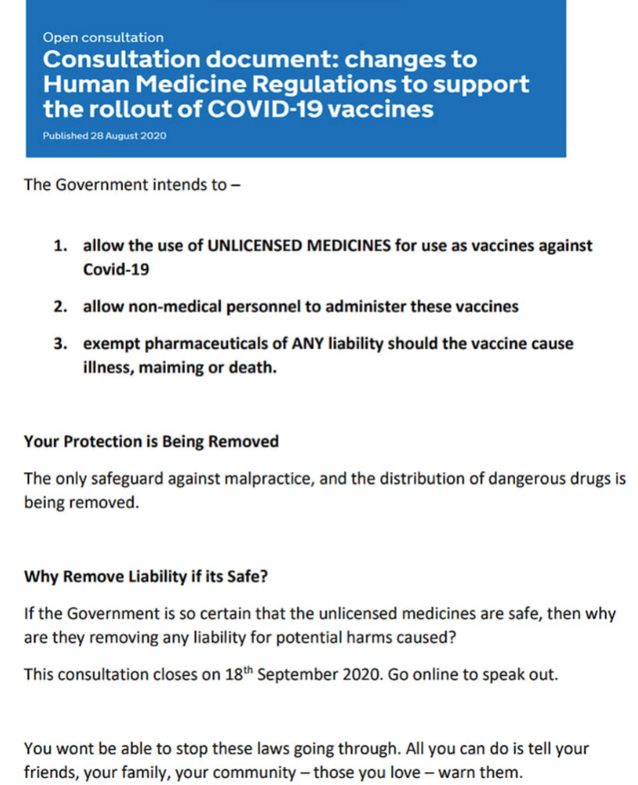
Dread
Denial of normal protocols: vit D, HCQ
Shutting down society
Arresting people for being outside
Strange lockstep behaviour – global madness
Masked muted zombies
Fake Recovery Trials – people were overdosed omn HCQ to discredit it.
Cancelling liability
Lockdowns would end when people took the experimental jab
Reference: https://howbad.info/obvious.pdf

Slide 3
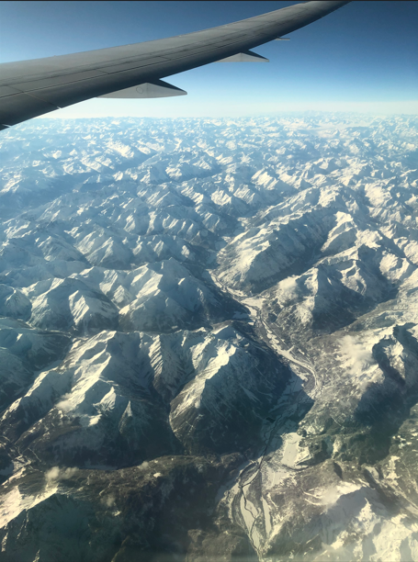
Escape
Seeing people on the common during furlough – I thought it would be their last summer.
Started looking for safe places to hide out – refuges
Bought lots of survival camping gear
Converted my garage
Bought a boat
Travelled to Dover to escape by boat out of England
Bought a plane ticket
Final day in UK – surrounded by masked and muted people – faceless zombies. A young African girl freaked out on the bus. She would not wear a mask – she began shouting and screaming. I said that we could do nothing – they are too powerful – too many.
We walked together to Sloane Square Tube station. A man approached us distraught. “Its not supposed to happen yet” he said “Not in my lifetime!”
“What?” she asked
“ The Tribulation” he blurted out. His eyes were burning with a kind of wild intensity.
I made up my mind. I was getting a plane out of England, and heading to the only safe place I knew. £1000 in my pocket, and a laptop in my bag. Nothing else.
That evening, as the plane rose above the roof tops of London, I felt a huge relief, as if I was escaping from a trap.

Slide 4
Political Action
Once there, in Tanzania, I warned everyone I met - I spoke in front of Churches to entire congregations, I talked to Masai tribes - who sat and listened around the camp fires on the distant plains, I visited the Parliament and met with the Health Minister's Deputy.
The health minister was provided with a document brief detailing the reasons for concern. Four copies were made - two for the Health Minister and her deputy, one for the prime minister, and one for the president Magufuli. The deputy minister sat with me, and asked me "What is going on? Why is it happening? Why are they doing this?"
I answered that I did not know, but it felt sinister. I told him that the motive was not typical of human greed, or ambition - because it seemed to go far beyond the scope of any individual, and seemed to override individual thought amongst the nations leaders. It felt evil.
I had never used that word before - in relation to world affairs - but it was the only word that could describe a mindless hunger to do harm acting upon all countries at once.
An appointment was arranged with President Magufuli, and I returned to my hotel to wait. Days passed, and I was informed that the meeting was delayed due to the funerals of ministers. A week passed, more ministers died. By the end of the month 12 ministers in his cabinet were dead, in some cases together with their wives. Then Magufuli himself disappeared. Something was taking them out. It felt dangerous.

Slide 5
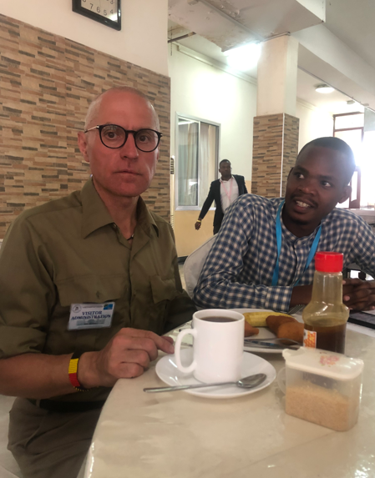
Me at the Parliament in Dodoma

Slide 6
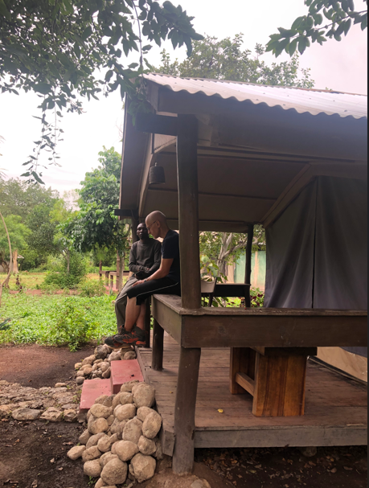
Fleeing to the Wilderness
I departed from Dodoma (where the Parliament is based) and headed north to the Serengetti - a vast wilderness bordered by poor villages There I obtained refuge in a Safari lodge. A week later I learned that Magufuli also had died. This was scary for me because I felt I knew who killed them.
I departed from the Serengetti and headed to the refuge of the northern mountains – a remote area called Usambara- by coach. A woman sat next to me. She introduced herself as a senior lawyer and friend of the new president Samia. We talked. I told her of my sadness that Magufuli was gone. He was the last bastion of freedom - tears were streaming down my face. It was as if my hope was gone.

Slide 7
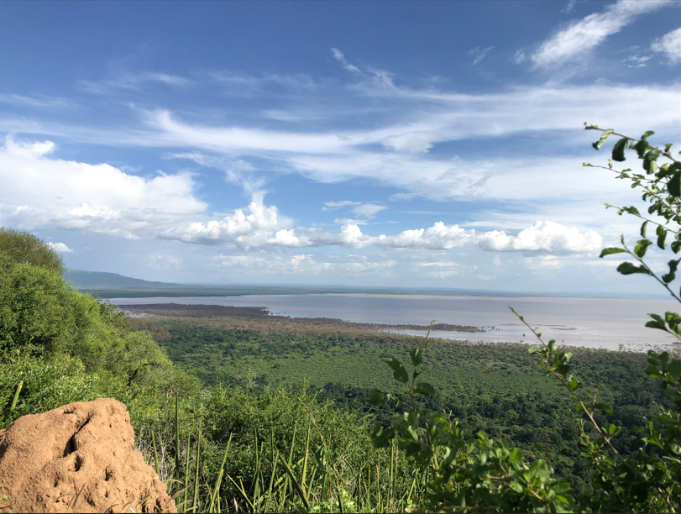

Slide 8
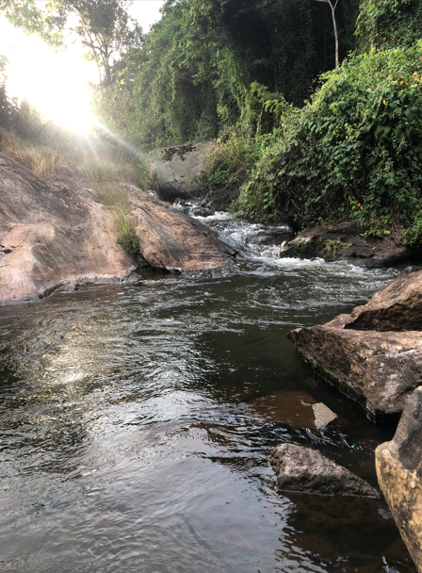

Slide 9
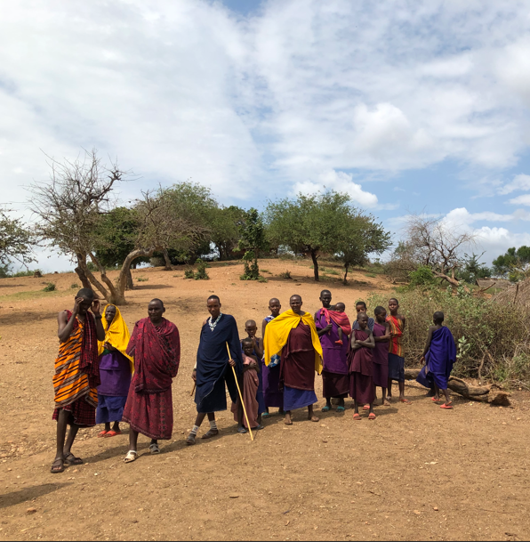

Slide 10
Grass Roots Resistance
All governments were now pro vaccine. Those who declined were removed. I felt it was a matter of time before the whole world became a medical tyranny. I could not survive in such a world. So began my grass roots approach. Researching a publishing on jab effects. If we could just change the minds of 10 or 20%, the world would become a much safer place.
Key publications were
Time till Onset – and the cover up of immediate vaccine deaths - https://howbad.info/time.html
The Second Peak – delayed effects and the mortality bomb - https://howbad.info/secondpeak.html
Death by Alphabet - https://howbad.info/alphabetic_toxicity2.pdf
Japan targeted by Pfizer’s most lethal lots - https://howbad.info/nationocidep2.pdf
Amyloid Clots and Undertakers - https://howbad.info/prion4.pdf
Death of Athletes and Pilots - https://goodsciencing.com/uncategorized/athletes-suffer-cardiac-arrest-die-after-covid-shot/
Falling Jab Recovery Rates - https://howbad.info/recov5.pdf
Thrombosis Paper - https://howbad.info/safety-signal-paper-5.pdf

Slide 11
All the Other Drugs
The exposure of the horrific effects of the Covid jab brought into question what other drugs might be dangerous.
I created the world’s first major search engine for vaccines that ranked every vaccine according to every symptom using all the VAERS data from its inception till now.
https://knollfrank.github.io/HowBadIsMyBatch/SymptomsCausedByVaccines/index.html
I then did the same for all drugs in the Eudravigilance database.
https://knollfrank.github.io/HowBadIsMyBatch/SymptomsCausedByDrugs/
It exposed some monsters – drugs that literally destroyed every bone in your body. Drugs that destroyed tendons. Drugs that caused infertility and abortion. Drugs that caused autism.
https://howbad.info/index.html#antibiotic
These search engines are public and available for all to see. I need funding to keep them going year to year. £400 per year.
Please donate here - https://howbad.info/donate.html. This seriously saves lives.

Slide 12
A Pervasive Evil
A man emailed me to say “I never believed in evil until now”. He was not referring to ordinary evil – like egotistic crime. This was something different. Something that could watch a man become paralysed, suffer intense pain, loose limbs from clotting, go blind, and tell him he was imagining it…
https://howbad.info/lawless.pdf
It was a level of evil unparalleled in my life time, and totally unexpected. I wrote this -
It is rare to witness such widespread disregard for law and for constitutional rights, such a concerted effort to deceive, and such insensitivity to the vast amount of damage and death caused. Throughout 2020 and 2021 we have seen the ability of seemingly "nice", "respected" people to flip into collaborating with and encouraging the poisoning of their patients or students or voters, and we have seen the brutal suppression of the truth with threats of immediate dismissal from employment, denial of medical aid, threats of criminal prosecution, threats of isolation/incarceration or locking out from education.
To me, it felt as if many trusted authorities had flipped - like "Dr Jekyll and Mr Hyde" - into a new personality - such was the extreme change in their social behaviour. The idea of "sleepers" came to mind - people in key positions suddenly activated to fulfil a monstrous role. It felt as if many had been "taken over" - their core values eclipsed - a sudden collapse of ethical standards amongst those knowingly instigating this deception.
The Bible speaks of such a time, when evil prevails - not in some remote external country - but within every community and within every country, globally and at once. The Bible describes this time as a polarisation, a division, a separation between those who choose good and those who choose evil. The goats are separated from the sheep, the wheat from the tares - they become distinct...they become obvious. Are we in such a time ?

Slide 13
Evil has a Name
42 months after lockdowns began social media (Twitter) was taken over by X, and the X logo was then modified to display a scratch.
Within the scratch was a message. It declares the evil that controlled 195 countries for 42 months
The Evil has a name.
This time coincided with a push for a digital system of control that is still being rolled out.
https://howbad.info/Dark-X-Hidden-Message-4.pdf

Slide 14
Post Covid
People have lost trust in authorities. They are seen to be corrupt, not just on a personal opportunistic level, but in their fundamental allegiances – they have ceased to represent the people, and support interests that are treasonable and alien.
So, amongst the young – those subjected to lockdown and masking and social isolation during all their school years – those whose friends were injected and suffered heart damage – there has arisen a need for truth, the need for a real ethic, a new idealism.
People have awoken to the corruption – to the darkness – and they are choosing the light – there is a coming together of the people – a warmth and care that was not there before. Reliance on each other is safer than reliance on remote authority.

Slide 15
The Restoration of Natural Law
The nihilism and cynical ambition of the past is replaced by an ethic of objective Good – based on the objective purpose in nature, and in the source of nature.
I argue that purpose manifests in biological systems and is extremely pervasive. It is literally everywhere.
Such objective purpose implies an obligation to respect the purposes for which other creatures are made – to allow their fulfillment and not hinder it. To do no harm – where harm is defined as malfunction (the hindrance of natural purpose)
https://howbad.info/purpose-nature-6.pdf

Slide 16
Signs in the Heavens
My proposal is that UFOs are what in past times were called Angels. They transcend physical law – their material properties such as mass, volume, inertia, visibility, can vary according to their intention.
Their shapes also vary by intention, and consequently their shapes can convey a message. I have plotted how their shapes change every year from 1955 to 2026.
Here is what I found.
https://howbad.info/ufo-nature-cc.pdf

Slide 17
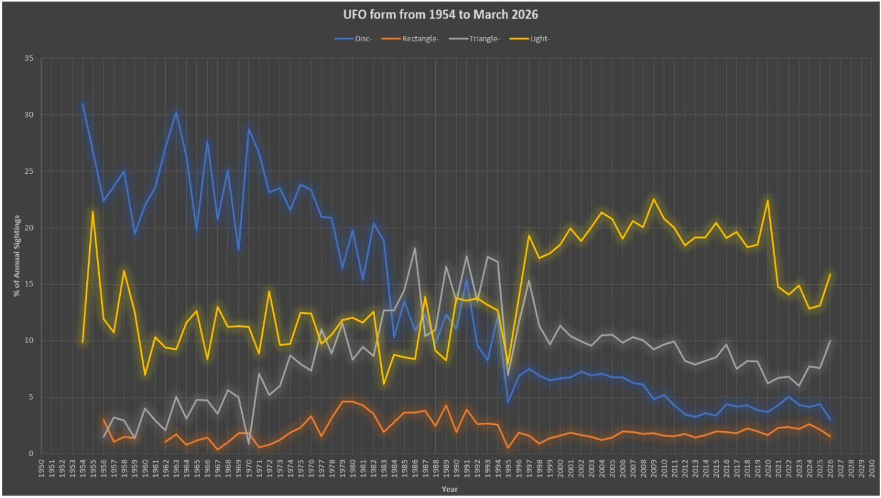

Slide 18
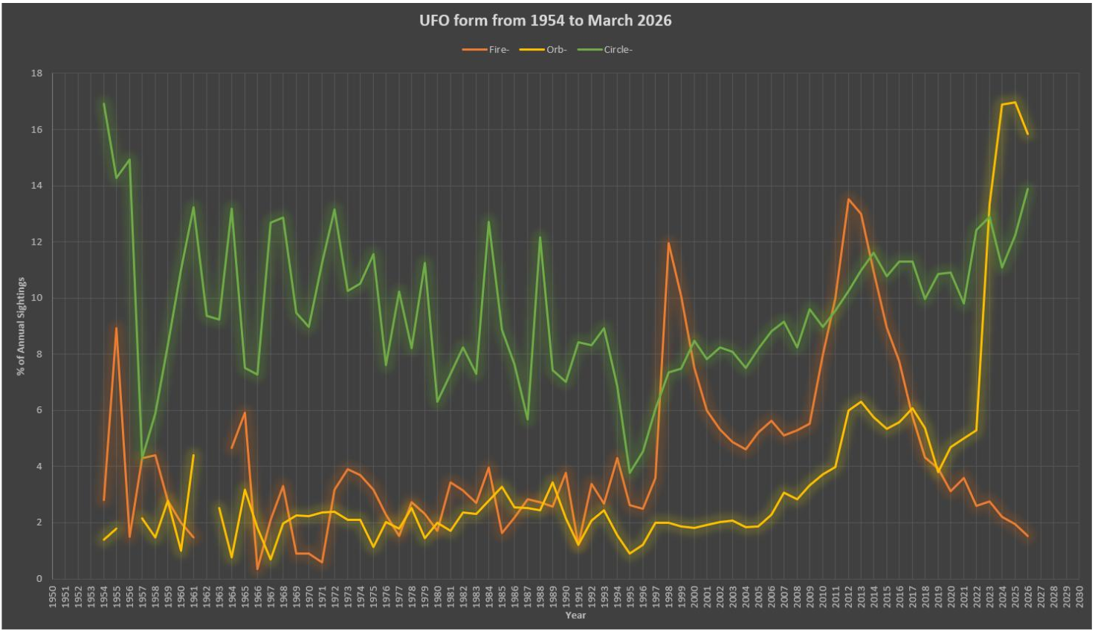

Slide 19
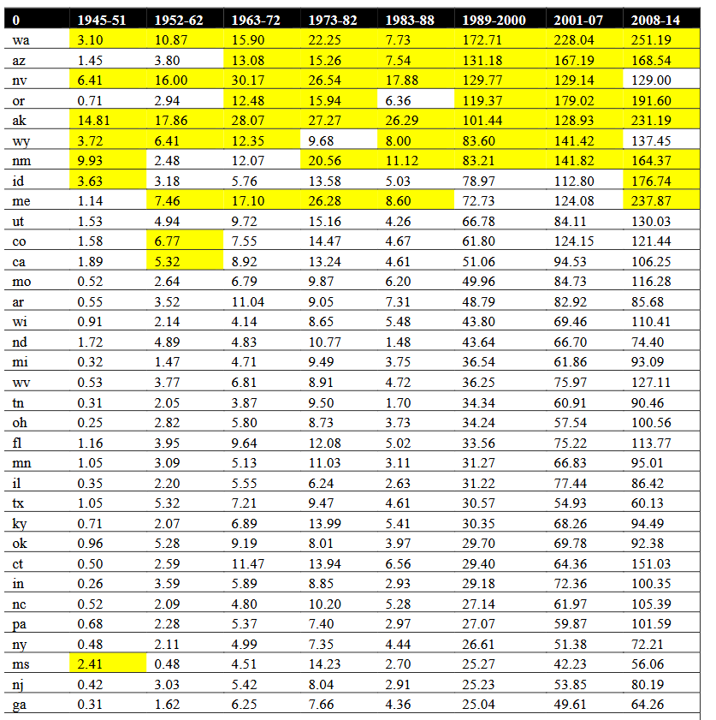

Slide 20
They say if I am allowed to speak I will dig my own hole and bury myself.
Well, I am just stating it how it is. Talking about UFOs makes me sound like a flat earther. But they are real, and they are definitely not physical in the sense that you and I are.
And my guess is that their shapes are conveying an important message – perhaps reflecting our culture back to us.
They are signs of the times, and signs for the future. They indicate that something beautiful has happened. The ascendence of a new idealism – the demise of the sleepers, but the arising and awakening of many as lights.
I have written three books. Please email me. I will send you a link to a free copy. I desperately need reviews to boost ratings. My email is craig@howbad.info . I need your reviews to get Amazon ratings, otherwise my books are invisible.
If you would like to donate in support of my work – please donate here - https://howbad.info/donate.html

